Slide 1
Project 3 Machine Learning

Slide 2

Objective
NOTE:
To change images on this slide, select a picture and delete it. Then click the Insert Picture icon
in the placeholder to insert your own image.
Use Machine Learning to predict which teams will make the playoffs.

Slide 3
How?
Data consisted of raw scores from the 2012-2019 NBA Seasons and betting lines from regular season and playoffs
Logistic Regression – add scores
Random Forest Model – 89.5% accuracy
Matplotlib – used for additional visualizations
Tableau – KPI’s used for validation
Power BI – KPI’s used for validation
Machine Learning models validated factors influencing a team’s chance of making the playoffs

Slide 4
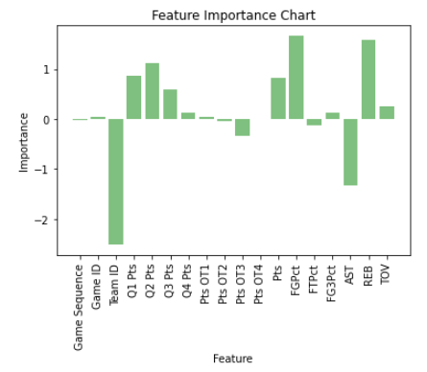
Log Regression-Feature Importance 12
Field Goal Percent and Rebounds were the most important features for the 2012 season.

Slide 5
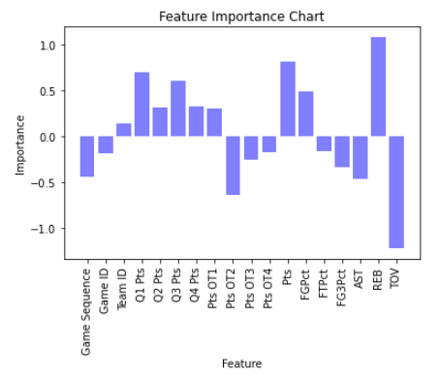
Log Regression-Feature Importance 15
Rebounds and Total Points are the most important feature for the 2015 season.

Slide 6
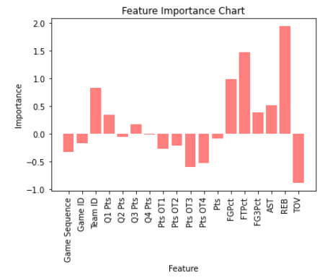
Log Regression-Feature Importance 18
Rebounds and Free Throw Percentage are the most important features for the 2018 season.

Slide 7
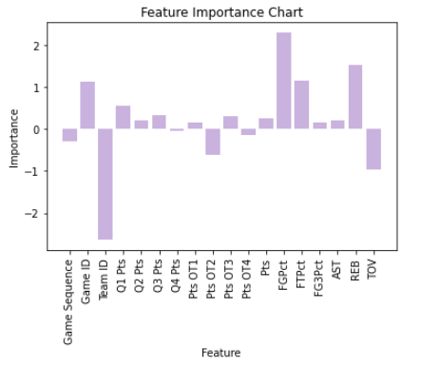
Log Regression Feature Importance All Data
Overall Field Goal Percentage, Rebounds and Free Throw Percentage are the most important feature in the seasons from 2012-2019.

Slide 8
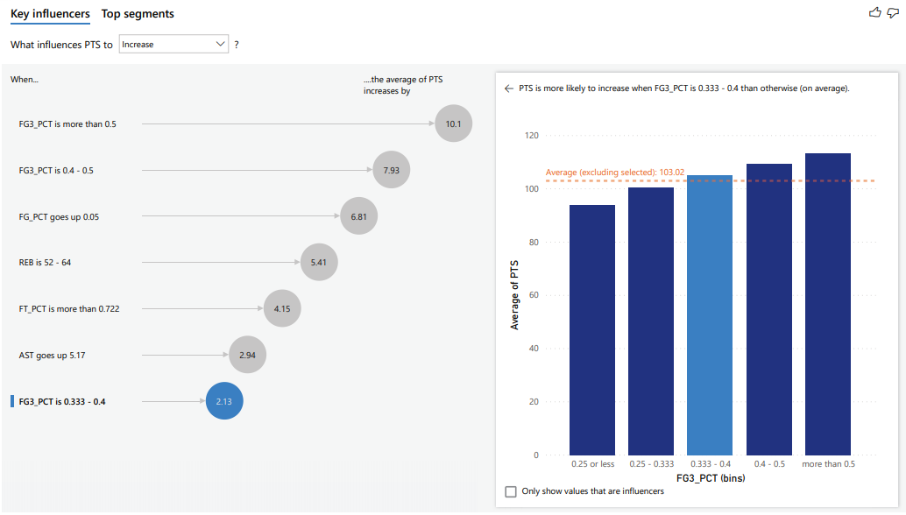

Slide 9
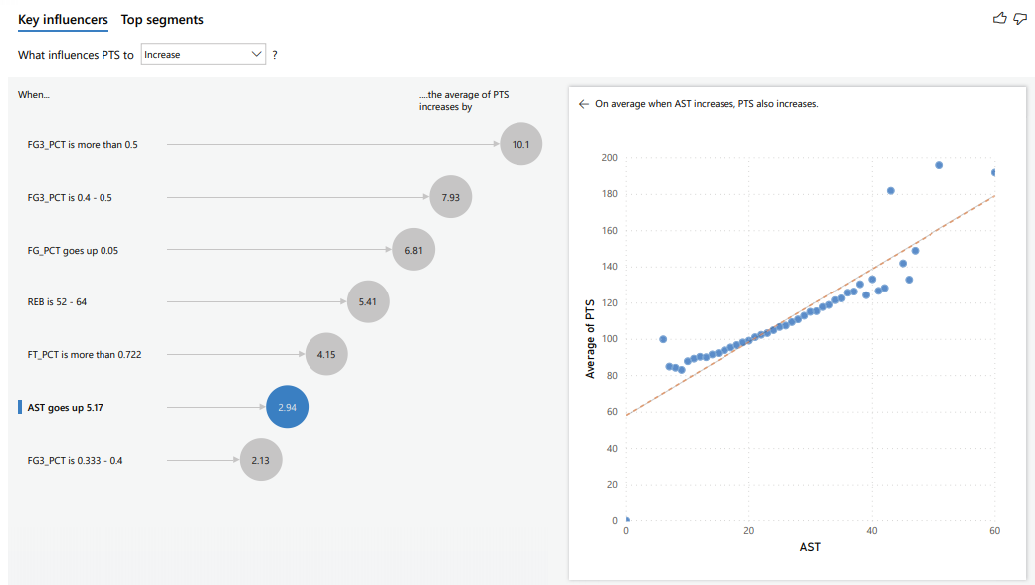

Slide 10
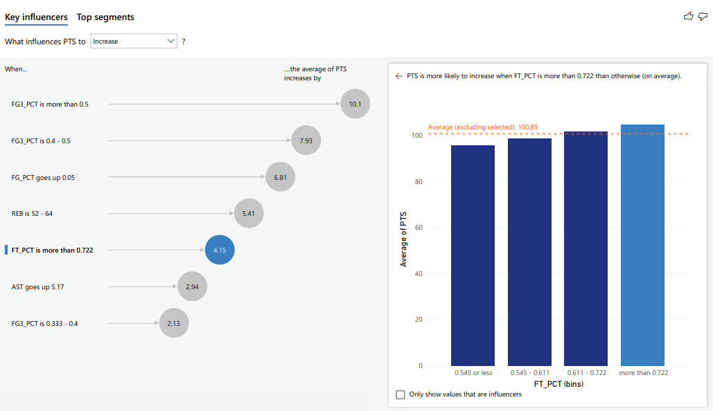

Slide 11
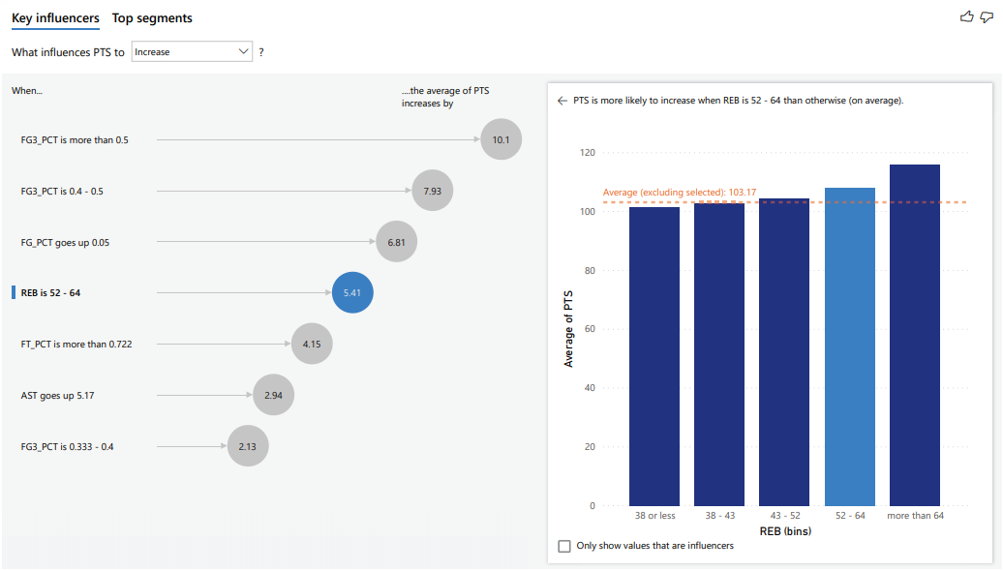

Slide 12
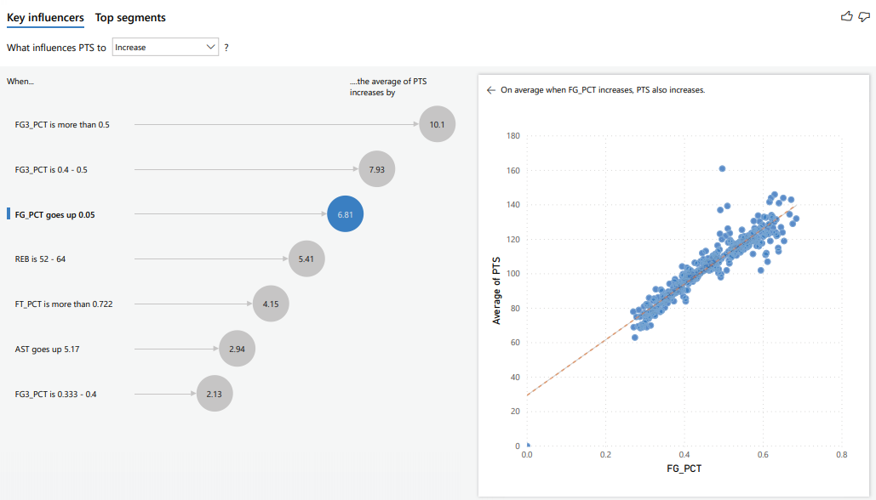

Slide 13
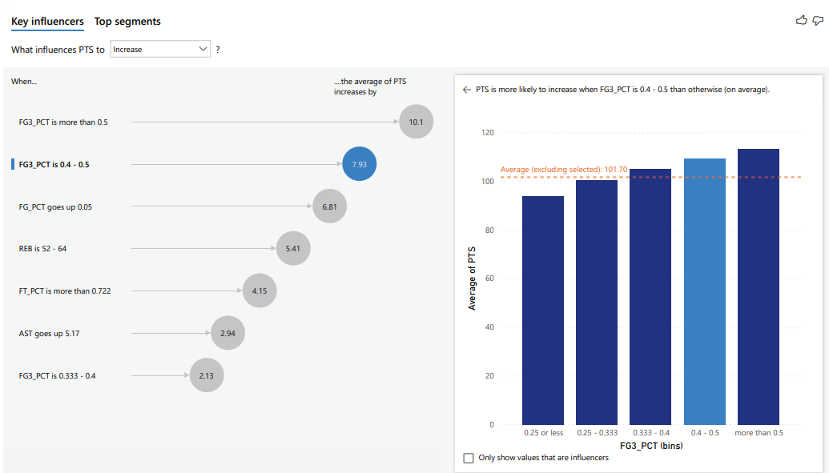

Slide 14
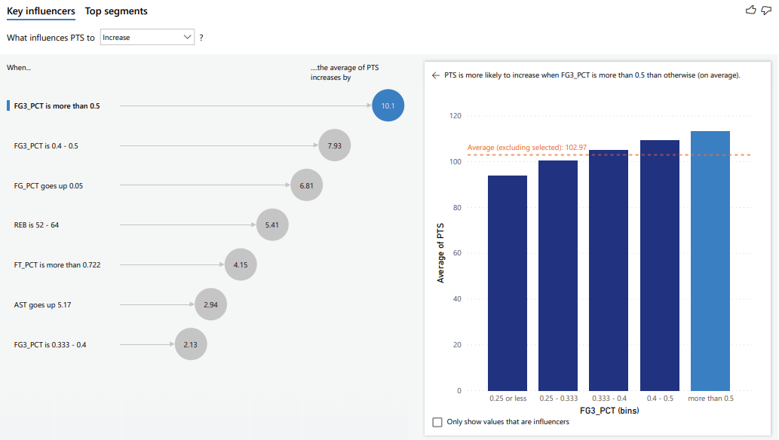

Slide 15
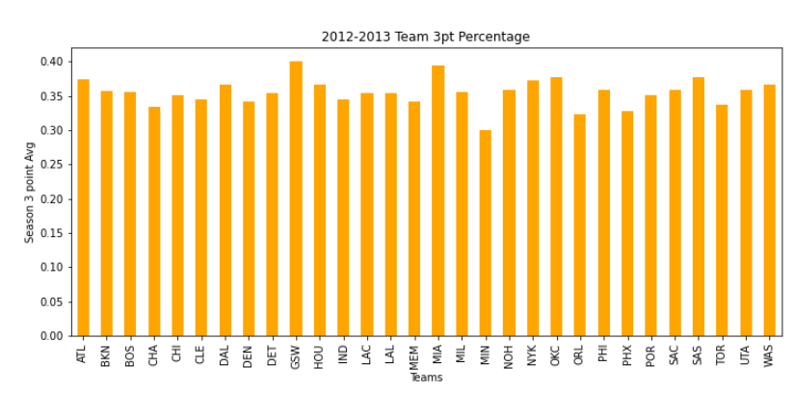
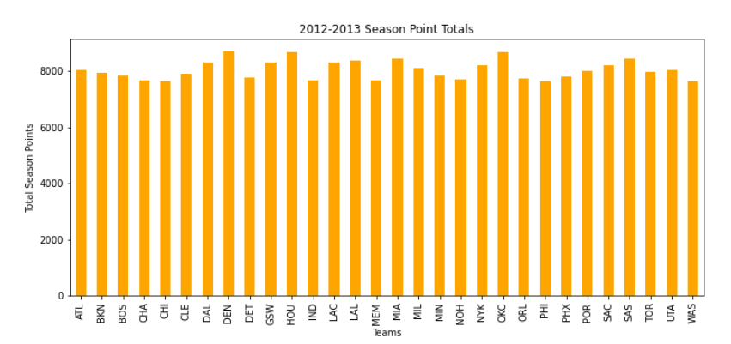
2012-2013

Slide 16
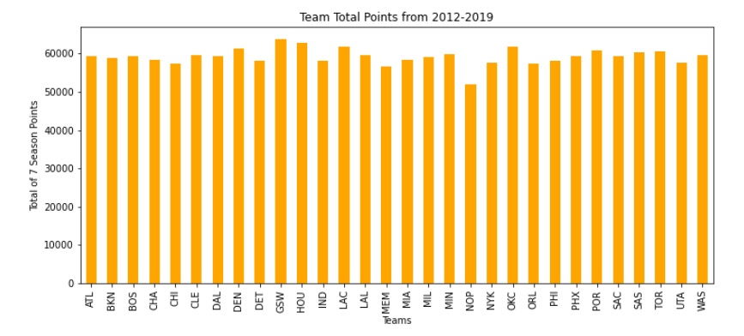
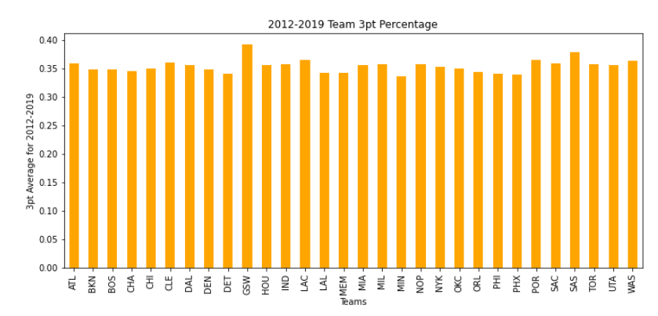
2012-2019

Slide 17
Free Throws Win Games!!!

Slide 18
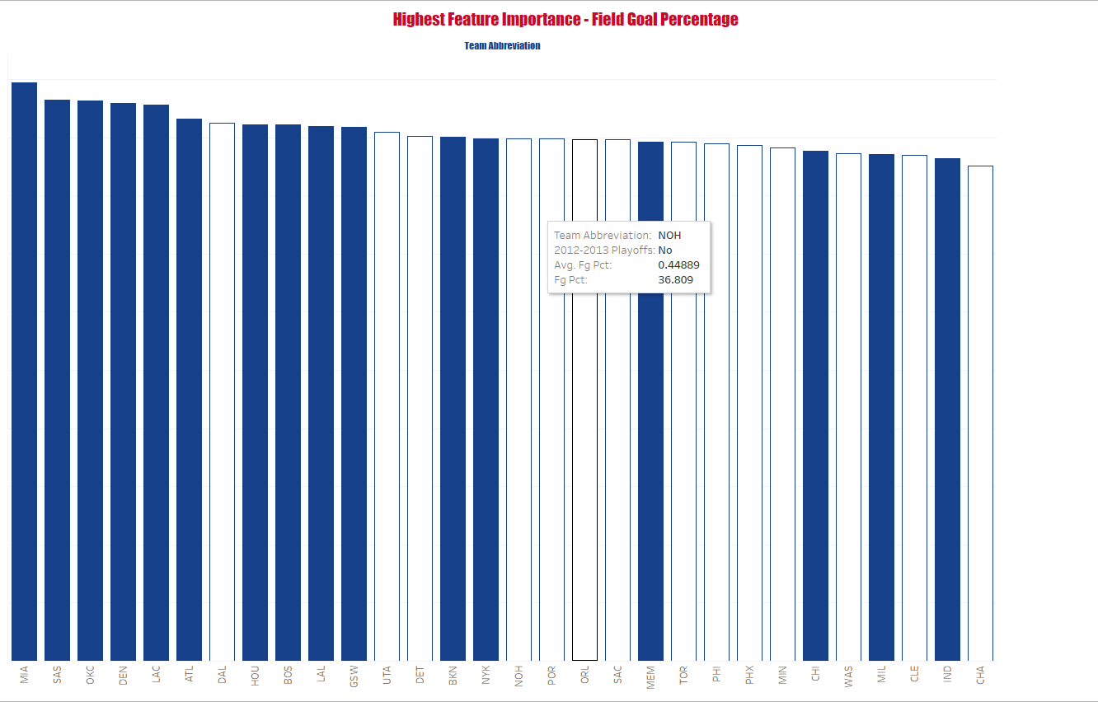
Highest Feature Importance – Field Goal Percentage 2012 – 2013 Season
Caption

Slide 19
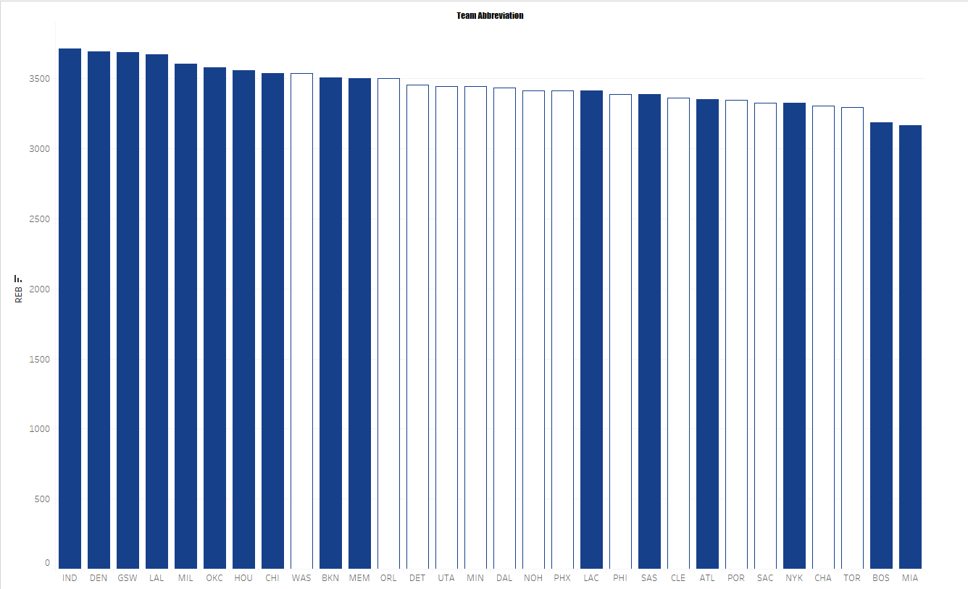
Importance – Rebounds 2012 – 2013 Season

Slide 20
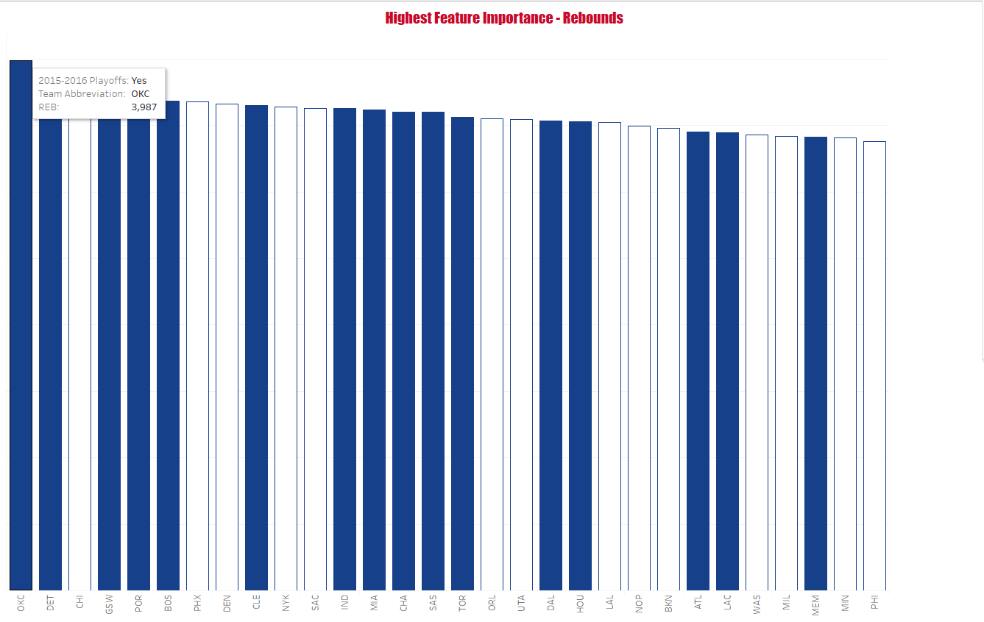
Highest Feature Importance – Rebounds 2015 – 2016 Season

Slide 21
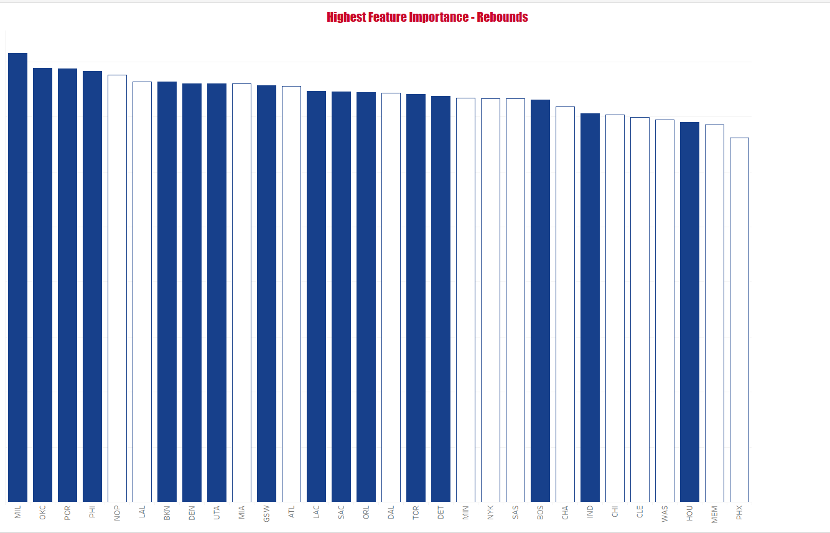
Highest Feature Importance – Rebounds 2018 – 2019 Season

Slide 22
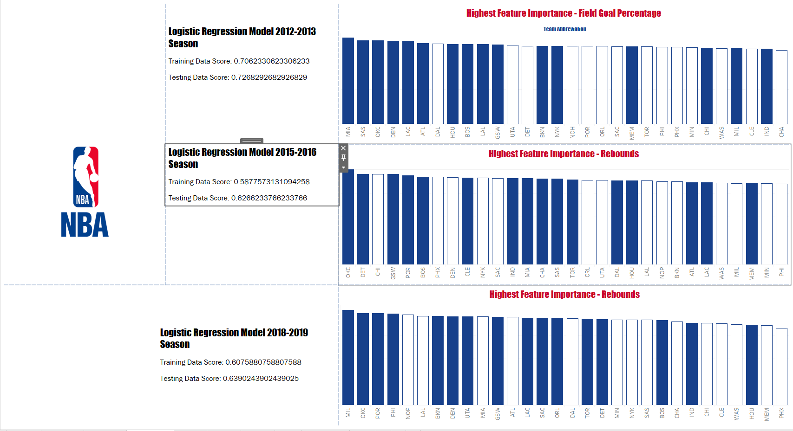
Dashboard
Logistic Regression of Highest feature Importance over three seasons

Slide 23
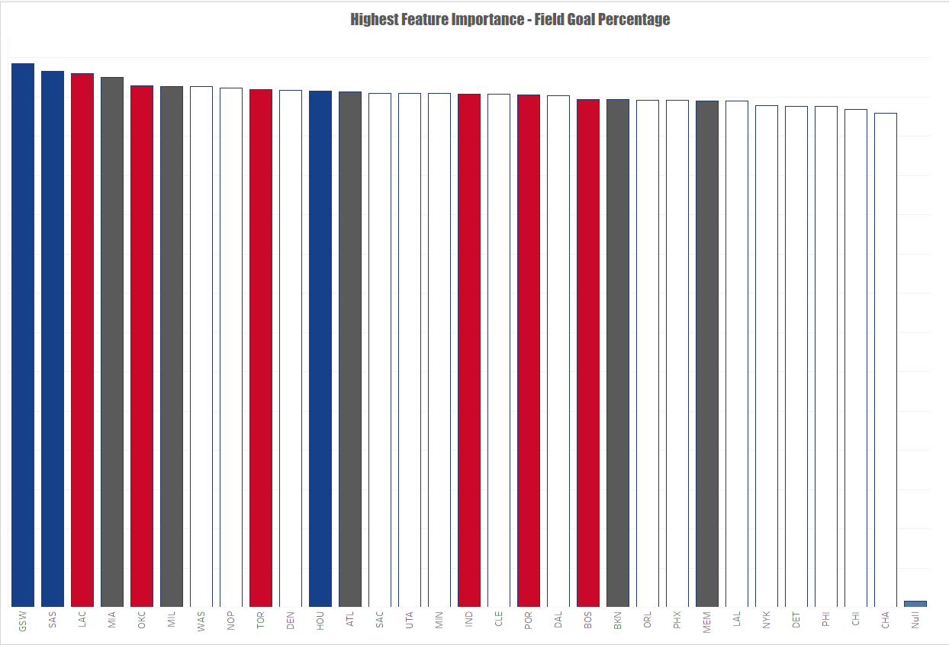
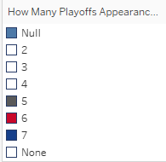
Overall Highest Feature Importance – Field Goal Percentage
Field Goal Percentage over the 7 seasons and its correlation to Playoff runs

Slide 24
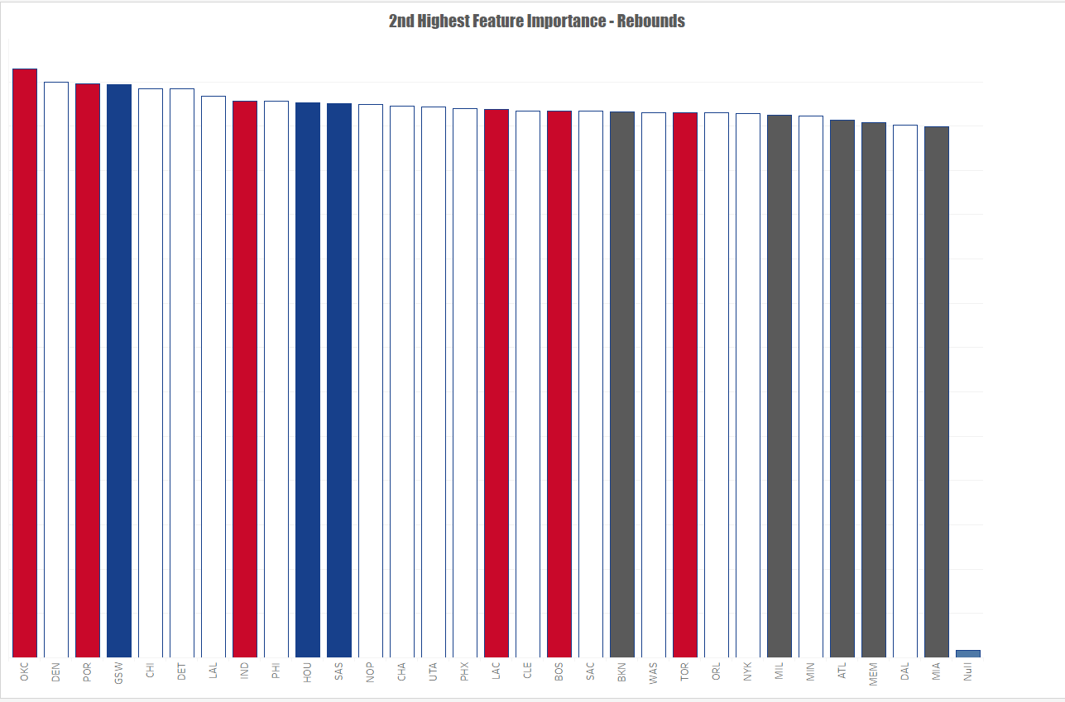
Second Highest Feature Importance – Rebounds
Total Rebounds over the 7 seasons and its correlation to Playoff runs

Slide 25
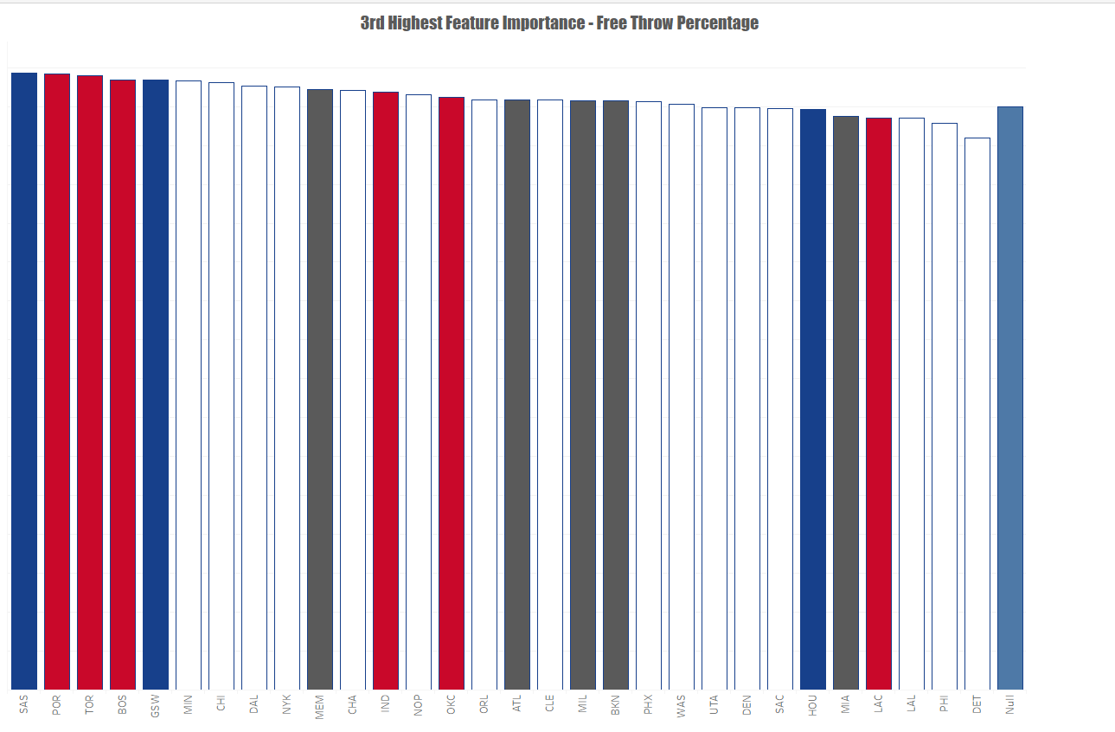
Third Highest Feature Importance – Free Throw Percentage
Field Goal Percentage over the 7 seasons and its correlation to Playoff runs

Slide 26
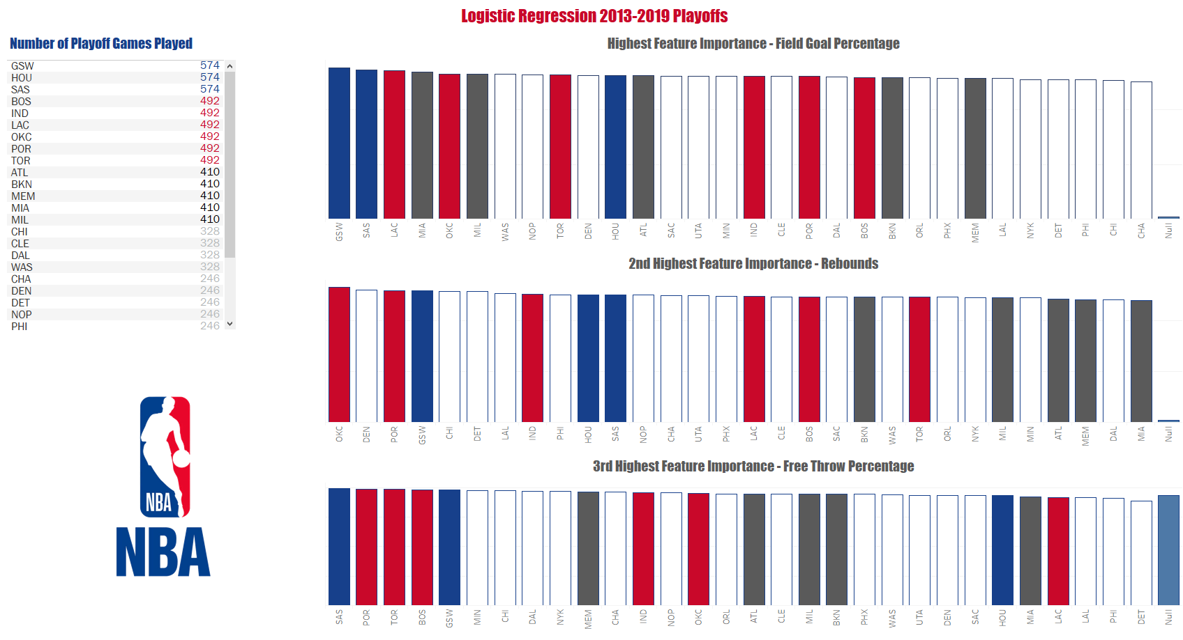
Dashboard
Logistic Regression of the most important features over the 7 years and its correlation to Playoff runs.

Slide 27
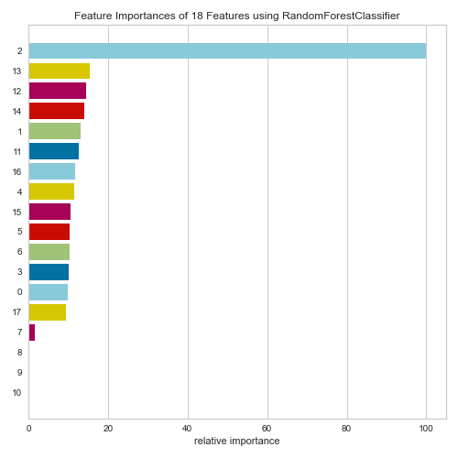
Random Forest Classifier

Slide 28
Two Content Layout with Table
First bullet point here
Second bullet point here
Third bullet point here
Class | Group 1 | Group 2
Class 1 | 82 | 95
Class 2 | 76 | 88
Class 3 | 84 | 90

Slide 29
Add a Slide Title - 1

Slide 30
Add a Slide Title - 2

Slide 31
Add a Slide Title - 3

